Slide 1

Exam AZ-700: Designing and Implementing Azure Networking Solutions Crash Course
Tim Warner

Slide 2


Tim Warner
Based in Nashville, TN, US
Central time zone
Twitter: @TechTrainerTim
Web: TechTrainerTim.com

Slide 3
Day 1 of 2 Agenda
Introduction
Hybrid Networking
Core Networking Infrastructure
Routing, Start

Slide 4
Day 2 of 2 Agenda
Routing, Finish
Secure and Monitor Networks
Private Access to Networks

Slide 5
Course Materials
timw.info/az700

Slide 6
A Different Kind of Training
This is an Associate (not Fundamentals) certification, so we will move quickly and assume intermediate-level Azure skills
CompTIA Network+ covers Ethernet and TCP/IP fundamentals
2 hours / 15 minute break / 1 hour 45 min
Plan on reviewing the playback recording

Slide 7
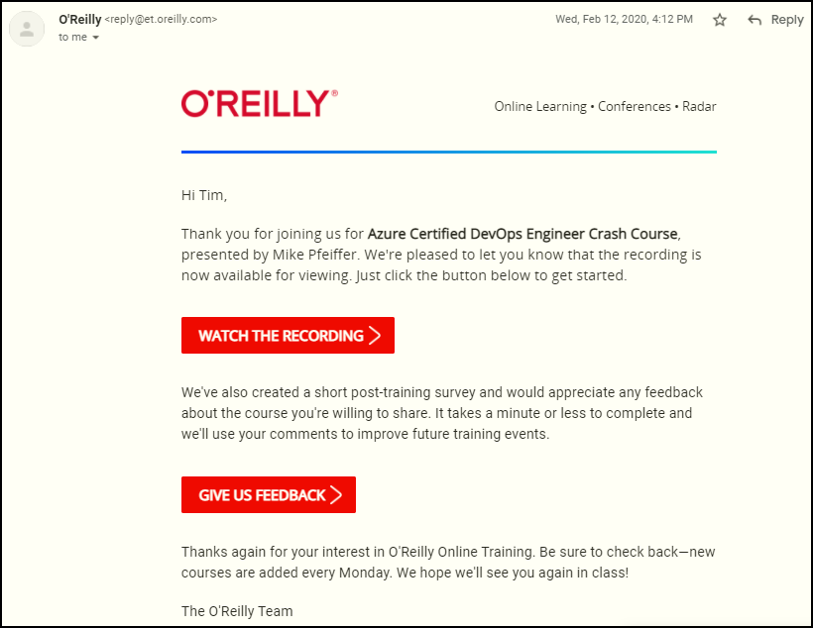
Session Recordings

Slide 8

Session Recordings

Slide 9

Session Recordings

Slide 10


Session Recordings

Slide 11
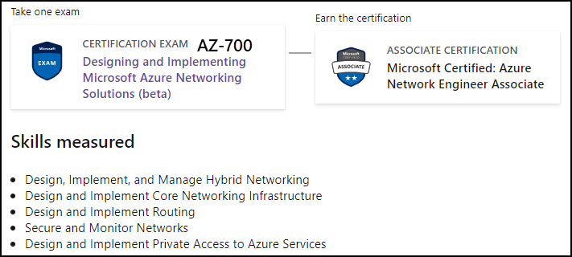
Azure Network Engineer Associate

Slide 12

Tim's Certification Study Model
Content knowledge
Test-taking skills
Practical application

Slide 13
Thank you!
Course materials: timw.info/az700
Twitter: @TechTrainerTim
Work: timw.info/ps
Web: TechTrainerTim.com

Slide 14
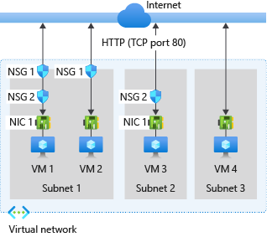
Multiple NSGs

Slide 15
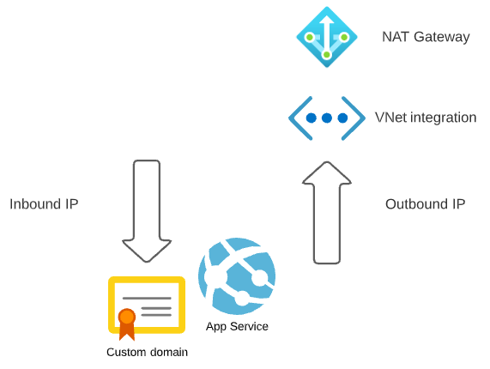
Azure App Service

Slide 16
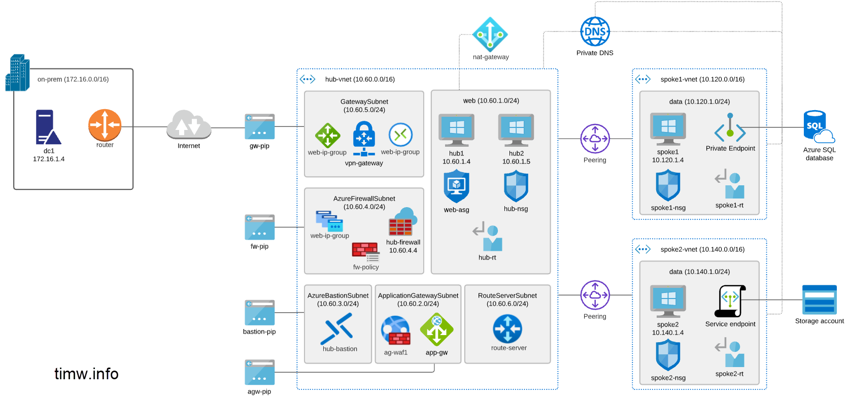
Azure Private DNS
168.63.129.16

Slide 17

VM Networking

Slide 18

Site-to-Site VPN

Slide 19
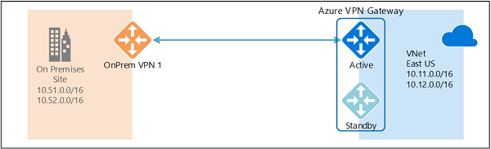
Active/Active VPN Topologies

Slide 20
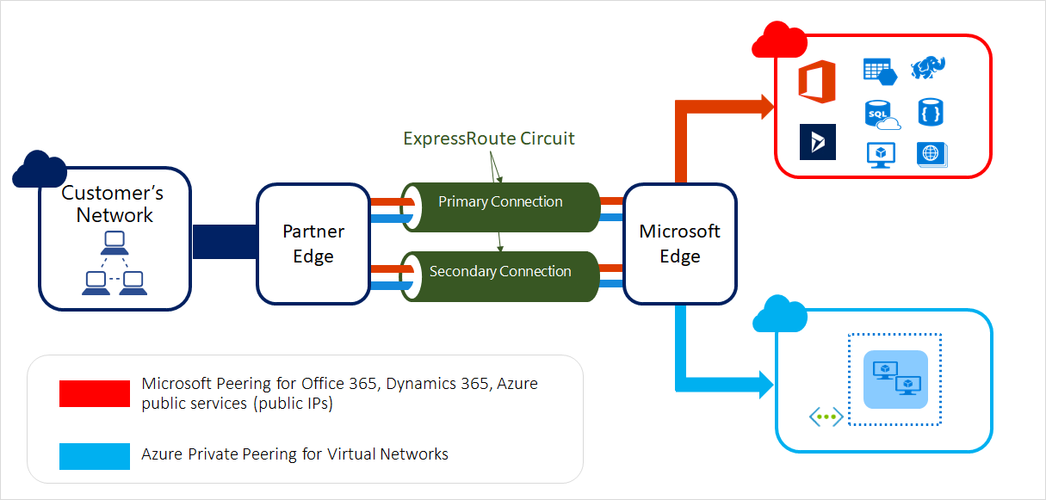
ExpressRoute Peering Types

Slide 21
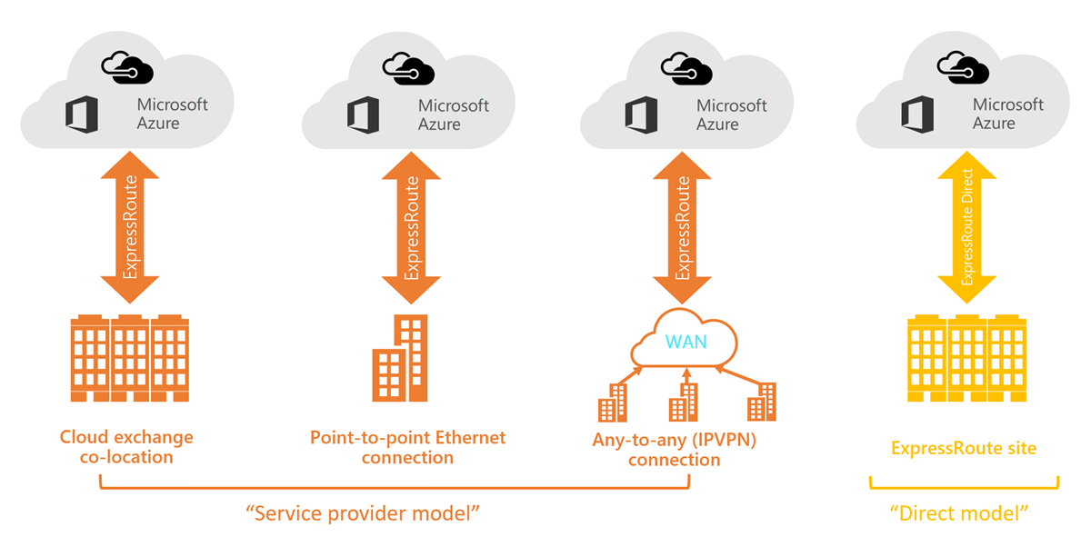
ExpressRoute Service Models

Slide 22
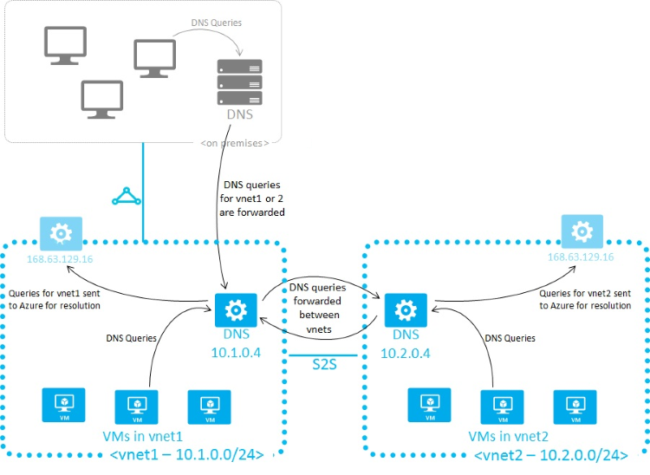
Azure Name Resolution

Slide 23
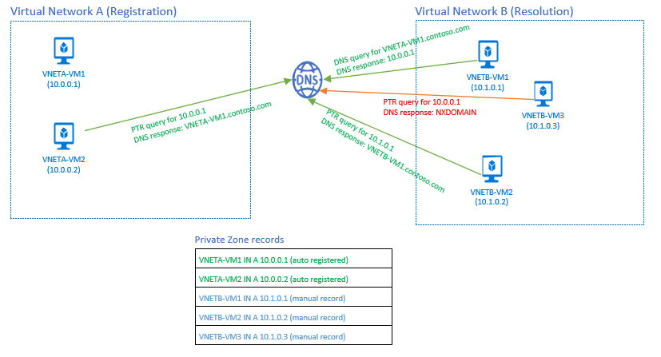
Azure DNS Private Zones

Slide 24
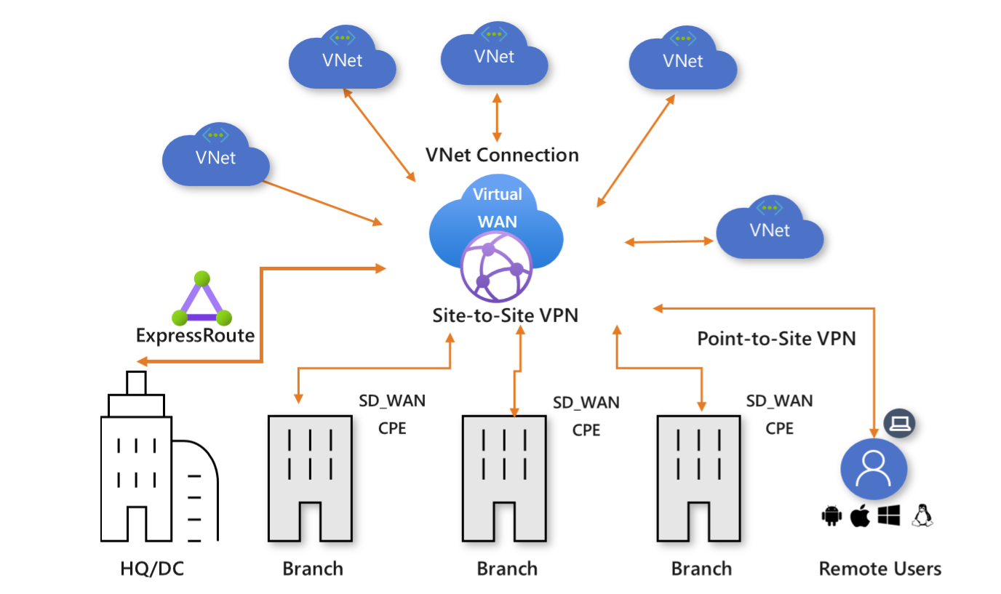
Virtual WAN

Slide 25
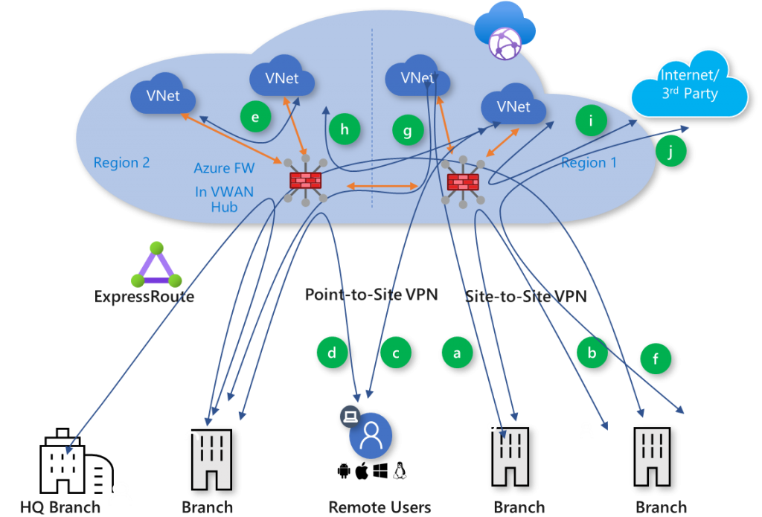
Secured Virtual Hub

Slide 26


Load Balancing

Slide 27

VNet Peering

Slide 28

Network Virtual Appliance

Slide 29

Azure Load Balancer

Slide 30

Application Gateway

Slide 31
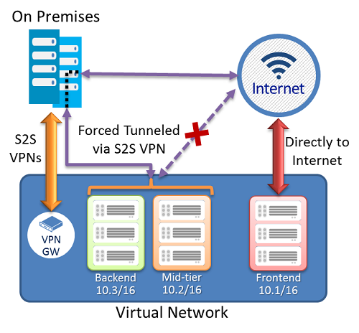
Forced Tunneling - S2S VPN

Slide 32
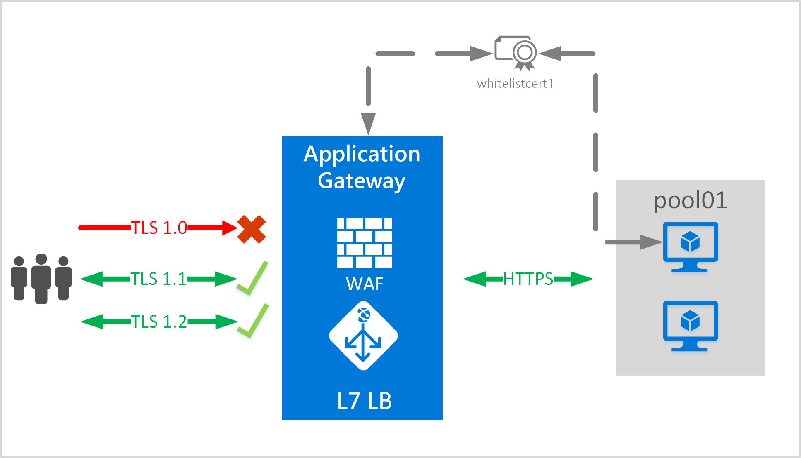

App Gateway E2E TLS

Slide 33
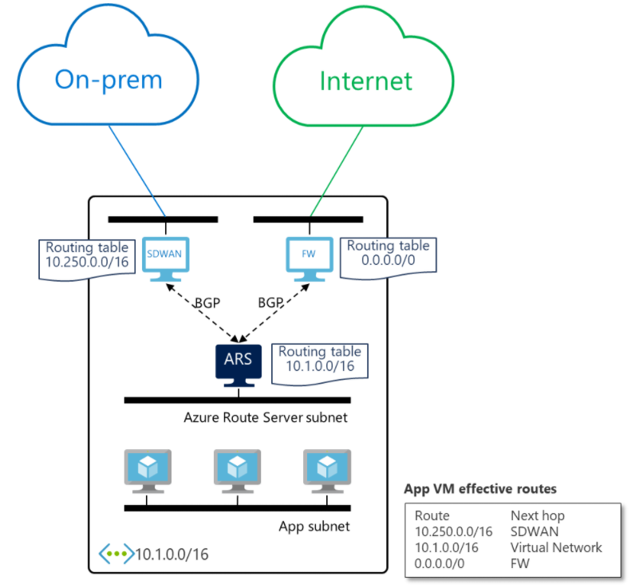
Azure Route Server

Slide 34
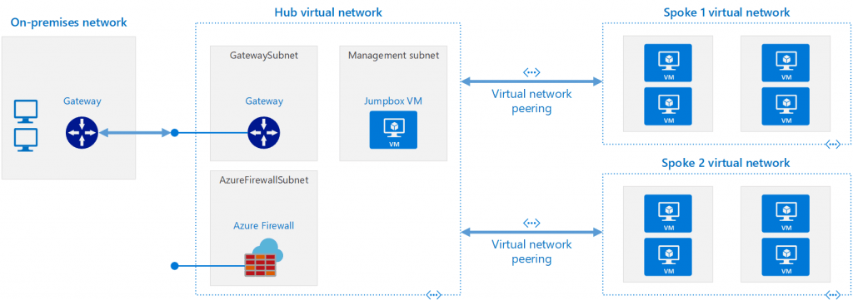
Network Virtual Appliance (NVA)

Slide 35
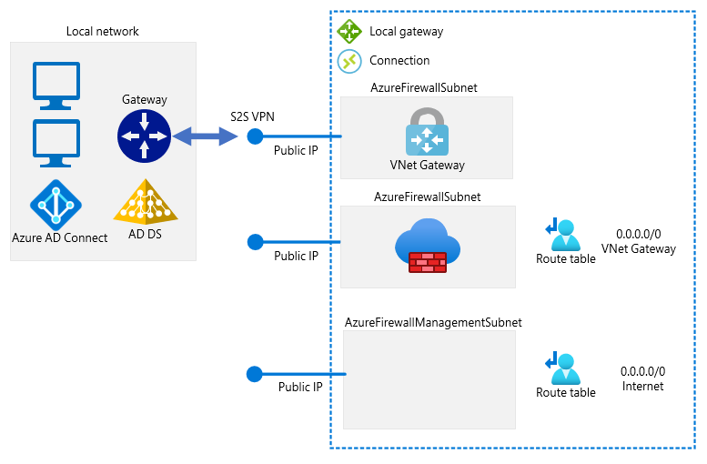
Forced Tunneling - Azure Firewall

Slide 36
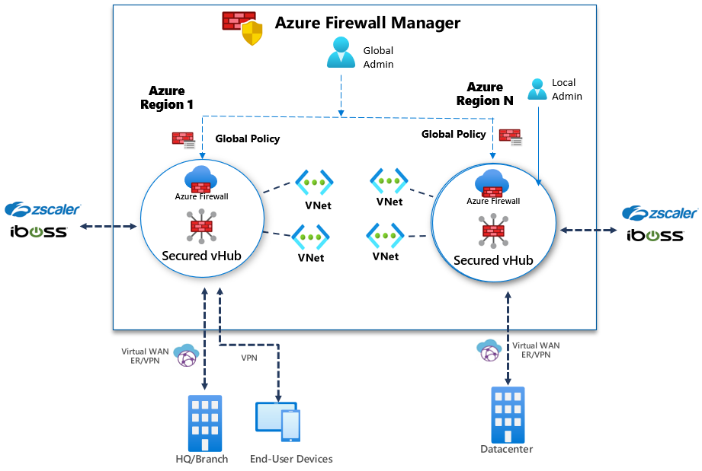
Azure Firewall Manager

Slide 37

Traffic Manager

Slide 38

Front Door Service

Slide 39
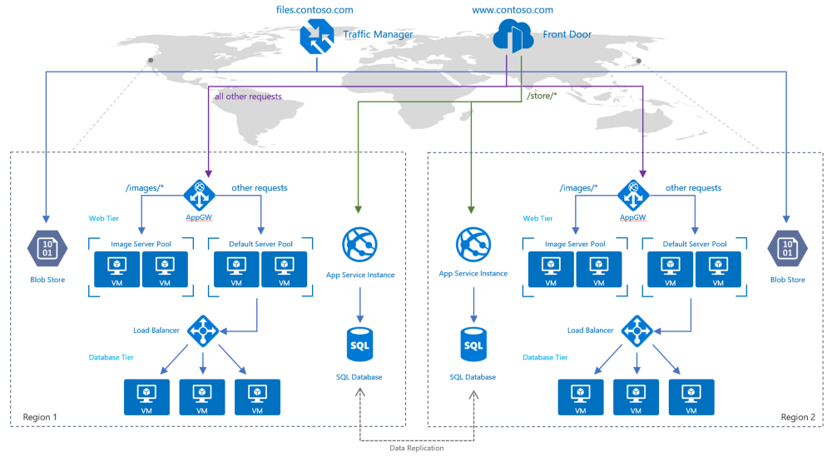
Traffic Manager vs Front Door

Slide 40
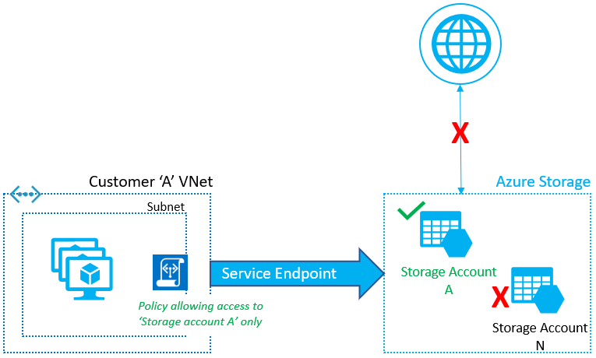
Service Endpoints

Slide 41
Private Endpoints

Slide 42
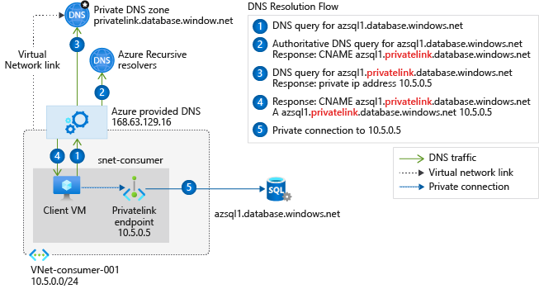
Private Endpoint DNS Config
Access from Azure

Slide 43
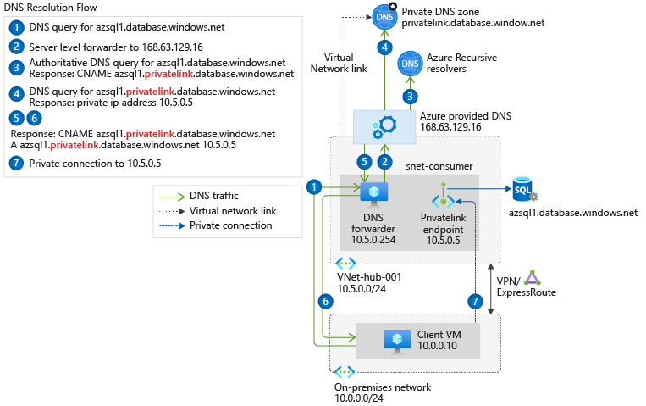
Private Endpoint DNS Config
Access from on-premises
Access from on-premises

Slide 44

Azure Monitor

Slide 45
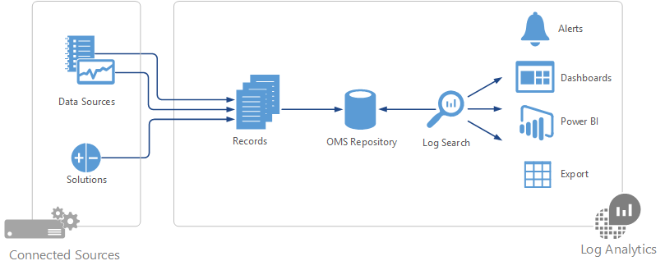

Log Analytics

Slide 46
Exam AZ-700 Item Types

Slide 47

Multiple Choice

Slide 48

Multiple Choice

Slide 49
Repeated Scenario
You need to move an Azure VM to another hardware host.
Solution: You redeploy the VM.
Does this solution meet the goal?
Yes
No

Slide 50
Repeated Scenario
You need to move an Azure VM to another hardware host.
Solution: You create a proximity placement group.
Does this solution meet the goal?
Yes
No

Slide 51

Select and Place

Slide 52

Build List and Reorder

Slide 53
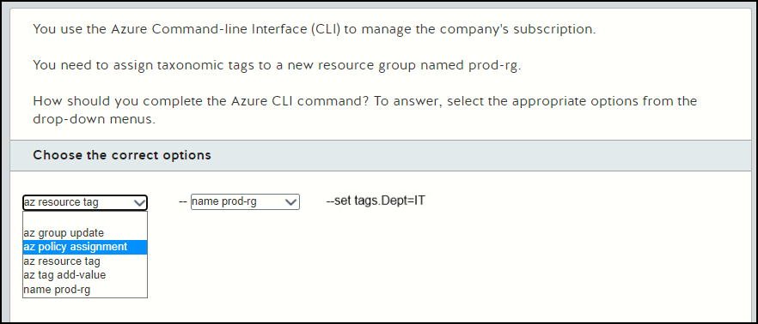
Active Screen

Slide 54

Case Study

Slide 55






Performance-Based Lab

Slide 56
Microsoft Online Testing Process
timw.info/online

Slide 57

Microsoft Online Testing Process

Slide 58

Microsoft Online Testing Process

Slide 59

Microsoft Online Testing Process

Slide 60

Microsoft Online Testing Process

Slide 61

Microsoft Online Testing Process

Slide 62

Microsoft Online Testing Process

Slide 63

Microsoft Online Testing Process

